Slide 1
Computing Project
Upton heath primary school
Chester

Slide 2
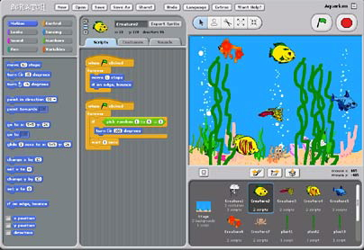
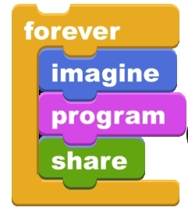
Year 3: Scratch
Amy, Danielle and Sarah

Slide 3
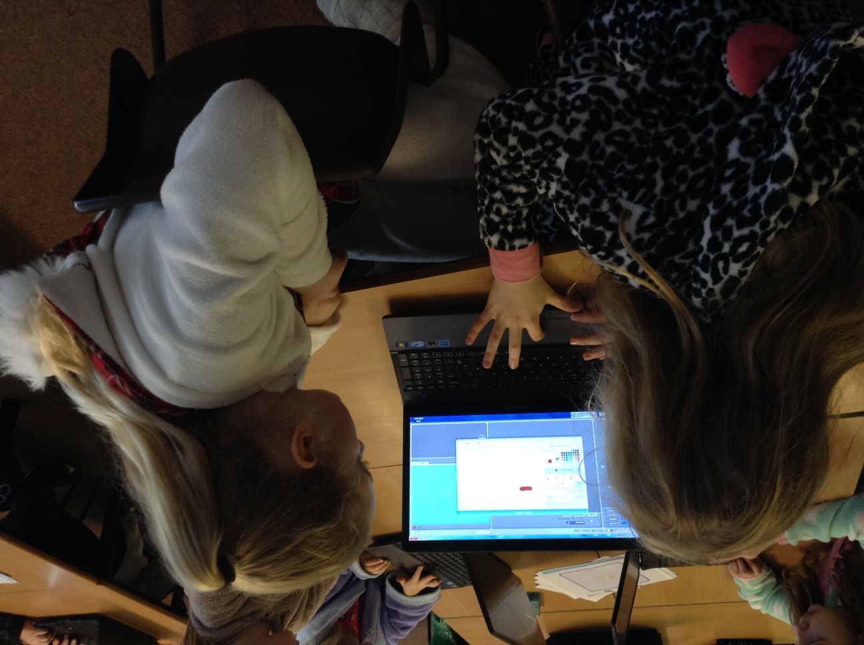
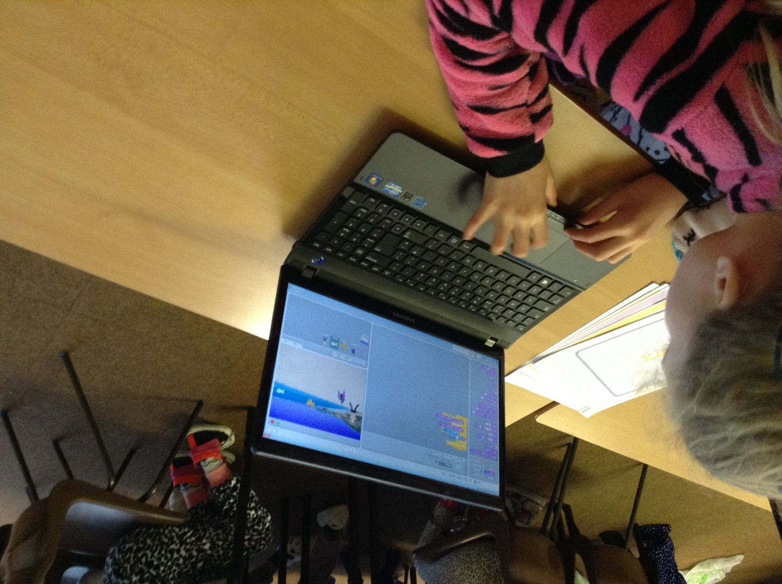
Success Crteria
Must | Change background Insert two sprites
Should | Forever/repeat button
Could | Try something new!

Slide 4
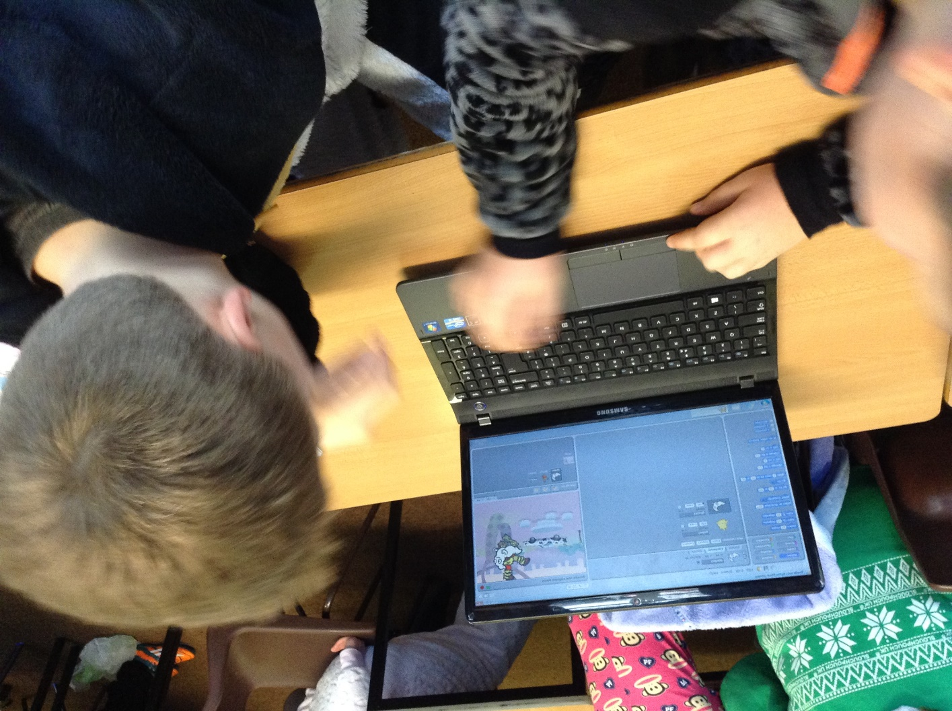
Year 5: Scratch Claire and Nick

Slide 5
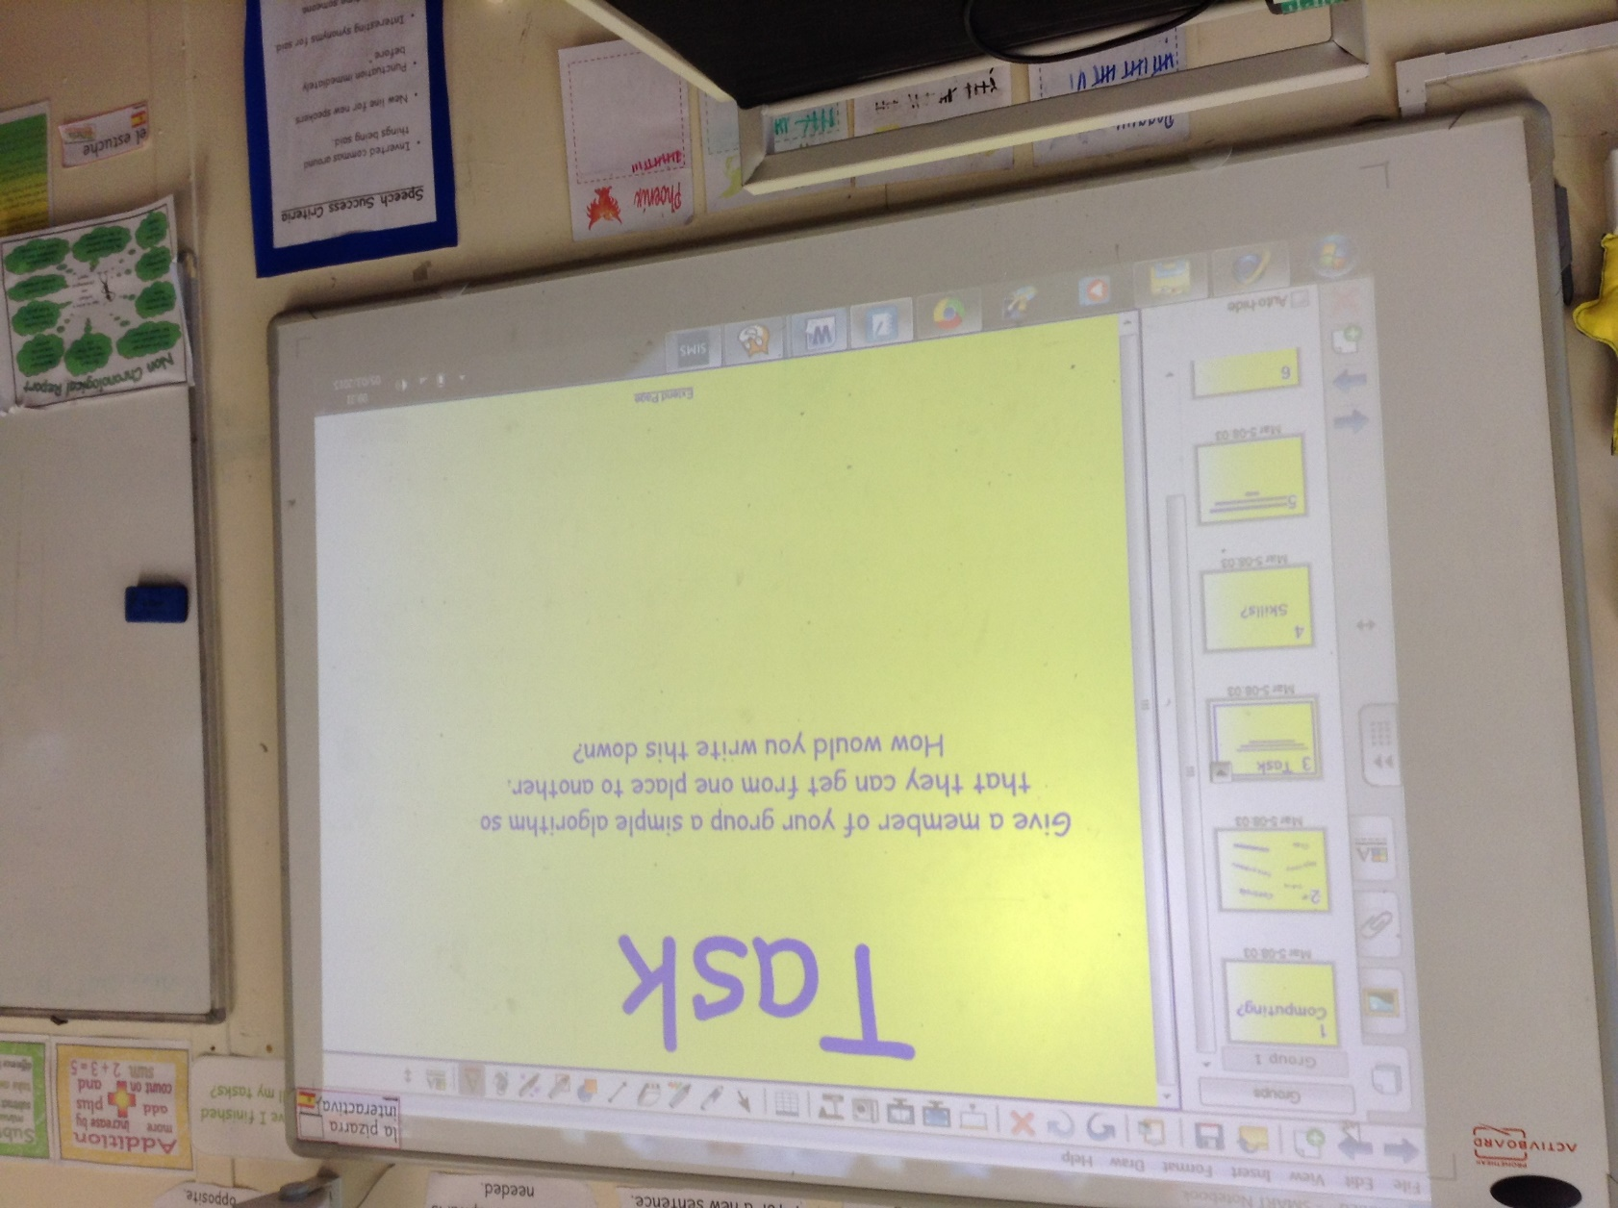
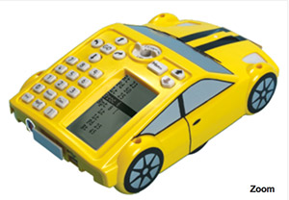
Year 4: Pro-bot Rob and Kath

Slide 6
Thank you!

